Slide 1
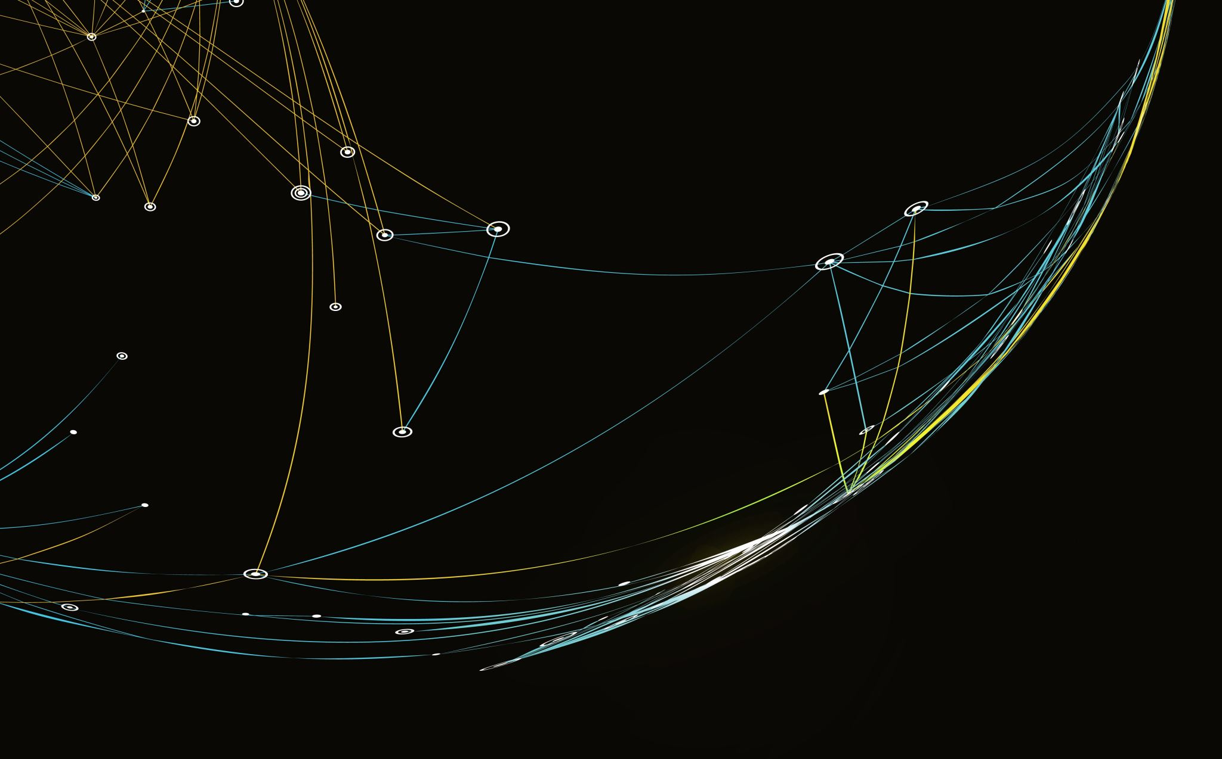
Četvrta nedelja Ponedeljak Jedanaesti Septembar/Rujan
Tamara Pavlović
BCS 2023

Slide 2
Pregled sedmice
WEEK 4
11.9. MON | Akuzativ i nominativ plural Reading and typing | Homework: Akuzativ and Nominativ Plural Resubmission: Writing Practice- Lesson 3 words Prep: Read pages 262-263
12.9. TUE | Prezent | Homework: Conjugation Resubmission: Akuzativ Homework (Week 3) Prep: 218-219
13.9. WED | Genitiv sa predlozima | Homework: Genitiv No office hours
14.9. THU | CG takmičenje Talk about your daily routine | Homework: Writing practice- Fill out the schedule
Flip, due Friday: Tell us about your daily routine Saturday- Questions Sunday- Answers Monday- Recommendations

Slide 3
Pregled sledećih nedelja
Week 5 | Mon, Sep 18- Vocab Quiz (L1-3) (Pages 2-4, 6, 8-13, 15-16, 18) Lesson 4 (Insturmental, Dativ, Predlozi) Oral Practice: Room Tour
Week 6 | Wrap up Test (L1-4)- Sep 26 Lesson 5- Special Verbs Recommendations will be movies
Week 7 | Movie Week

Slide 4
Shadowing
Article: https://www.fluentu.com/blog/language-shadowing/#toc_1
Video (long): https://www.youtube.com/watch?v=130bOvRpt24&t=15s
Video (short): https://www.youtube.com/watch?v=ljEP_ywBm7I

Slide 5
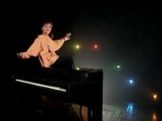

Slide 6
Прочитајте текст и прекуцајте на ћирилици

Slide 7
Nominative Plural
-E
-I
Feminine nouns that end in –a:
Drop -a add –e:
Lampa- lampe
Kuća- kuće
Žena- žene
Majka -majke
Noga -noge
Masculine nouns :
Add –i to the stem:
Rukav-rukavi
Papir-papiri
Kompjuter/kompjutor-kompjuteri/kompjutori
Balkon-balkoni

Slide 8
Masculine nouns that end in K/G/H
K/G/H + I = C/Z/S
K/G/H + I = C/Z/S
VOJNIK
JUNAK
ČINOVNIK
KOVČEG
DUH
SIROMAH
TEPIH
VOJNICI soldiers
JUNACI heroes
ČINOVNICI clerks
KOVČEZI trunks/coffins
DUSI ghosts
SIROMASI poor people
TEPISI rugs, carpets

Slide 9
MONOSYLLABIC MASCULINE NOUNS
Monosyllabic masculine nouns extend their stems in plural by adding -OV /-EV before the ending –I:
Rule: add -EV to the soft consonants:
Č, Ć, J, LJ, NJ,DŽ,Đ,Š,Ž (soft cons.)
MUŽ- MUŽEVI (husbands) NOŽ- NOŽEVI (knives)
BROJ –BROJEVI (numbers)
SLOJ -SLOJEVI (layers)
KLJUČ- KLJUČEVI (keys)
KOŠ –KOŠEVI (baskets)

Slide 10
MONOSYLLABIC MASCULINE NOUNS
Otherwise the ending is –OV:
Pod- podovi (floors)
Zid- zidovi (walls)
Sto/stol- stolovi (tables)
Sat-satovi (watches)
Brod-brodovi (ships)
Majority of the nouns will have –OV extension

Slide 11
Exceptions:
The following nouns will not extend their stem in the nominative plural:
These are very frequent and should be memorized!!!
Sat-sati (hours) (note: satovi-watches/clocks)
Konj-konji (horses)
Dan-dani (days)
Zub-zubi (teeth)

Slide 12
Irregular plurals
Due to frequency of usage these should be memorized:
ČOVEK/ČOVJEK: LJUDI (people)
GOSPODIN –GOSPODA (gentlemen)
BRAT- BRAĆA (brothers)

Slide 13
Neuter Nominative Plural Endings
-A
Polje Polja
Pismo Pisma
More Mora
Selo Sela
Irregular:
Oko oči

Slide 14
Vežba/vježba:
Klupa
Prozor
Učenik
Učenica
Profesor
Broj
Studentkinja/studentica
Drug
Drugarica
Klupe benches
Prozori
Učenici
Učenice
Profesori
Brojevi
Studentkinje/studentice
Drugovi
Drugarice

Slide 15
Vežba/vježba
Lekar/ljekar
Profesorka/profesorica
Soba
Pod
Plafon
Lekcija
Zid
Knjiga
Papir
Lekar/ljekari physicians
Profesorke/profesorice
Sobe rooms
Podovi floors
Plafoni ceilings
Lekcije lessons
Zidovi walls
Knjige books
Papiri paper

Slide 16
Accusative plurals:
Feminine nouns, F2, Neuter nouns have accusative plurals that are identical to their Nominative plurals.
Feminine:
Nom pl žene, majke, lampe
Acc pl žene, majke, lampe

Slide 17
F2 NOUNS
Neuter Nouns
Nom pl noći, krvi, ljubavi
Acc pl noći, krvi, ljubavi
N Nom pl sela, polja, pisma
Acc pl sela, polja, pisma

Slide 18
Masculine nouns (both animate (living things) and inanimate) change their ending in acc.plural to E:
Nom sg. prozor, zid, voz/vlak , profesor, stranac, učenik
Nom pl. prozori, zidovi, vozovi/vlakovi, profesori, stranci, učenici (K:C alternation before I)
Acc pl. prozore, zidove, vozove/vlakove, profesore, strance, učenike (no K:C alt. before E)

Slide 19
Adjectives- masculine and feminine plurals:
Adjectival ending is –E:
Gradske parkove, velike prozore
Dobre žene, lepe/lijepe lampe
F2: nove ljubavi, lepe/lijepe noći

Slide 20
Neuter plural
Have the same -A ending as neuter accusative plurals nouns and neuter adjectives:
Velika sela, moja pisma, duboka mora

Slide 21
Вежба- Make sentences using plural
Nouns: Žèna, grad, ljubav, rječnik, tèka, pas, òlovka, stvar, kàsa
Verbs: Vidim (I see), Imam (I have)

Slide 22
Za sutra
Homework: Akuzativ and Nominativ Plural
Resubmission: Writing Practice- Lesson 3 words
Prep: Read pages 262-263

